Slide 1

Weight Management – A Billion Dollar Opportunity with Vestige
🌿 Health
💪 Transformation
💰 Income Growth
Natural wellness solutions for sustainable transformation
Build residual income through repeat business
Visible results that inspire and motivate others

Slide 2
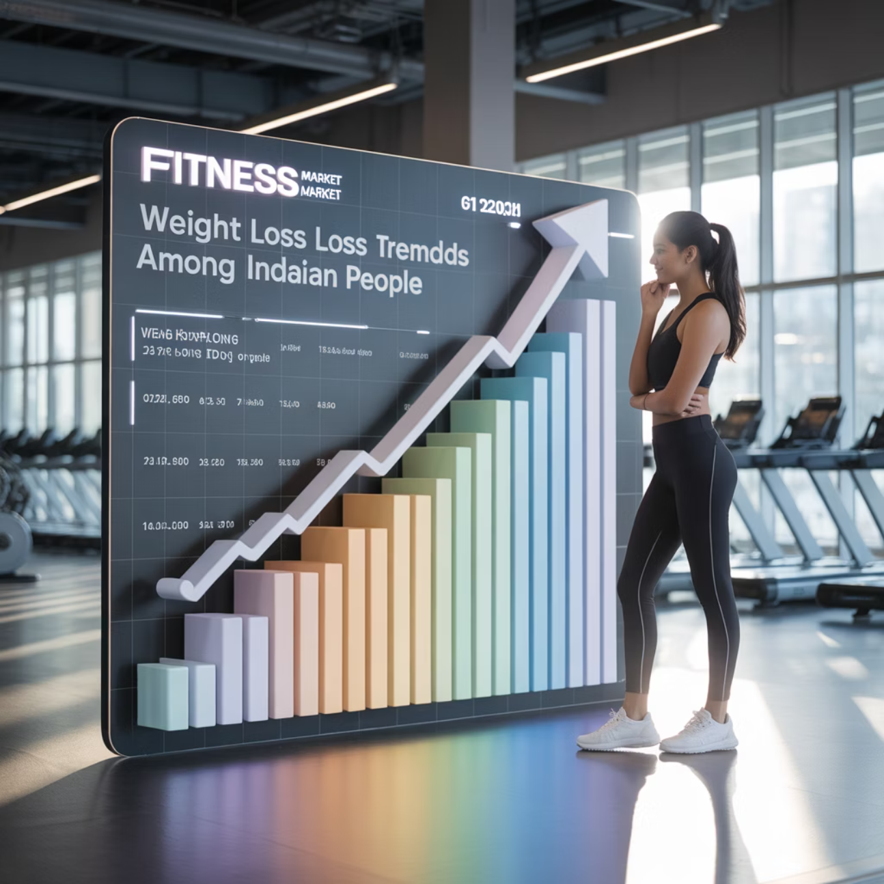
The Market Potential
$250B+
135M
Global Market
Indian Market
Weight management industry size and growing rapidly
People overweight/obese in India - huge untapped potential
Ready Audience
Every 2nd person wants to lose weight → Your ready-made audience waiting for solutions!
Evergreen Need
Weight management = evergreen need (not seasonal, always relevant)

Slide 3
USD 2,326 million ≈ ₹19,206 crore INR - 2033
Market | Size in India (latest) | Forecast / Growth | Key Drivers
Weight Management | ~ USD 25.2 billion in 2024. (IMARC Group) | Expected to grow to USD 55.9 billion by 2033 (CAGR ~ 8.79%) (IMARC Group) | Rising obesity, fast urban lifestyles, higher disposable income, social media & wellness awareness. (IMARC Group)
Alternate: Another source estimates ~ USD 22.0 billion market recently. (Ken Research)
Meal Replacements / Shakes | ~ USD 871.54 million in 2024. (IMARC Group) – 7200 Cr INR | Expected to rise to USD 2,326.65 million by 2033 (CAGR ~ 10.64%) (IMARC Group) | Urbanisation, health awareness, convenience, e-commerce growth. (IMARC Group)

Slide 4
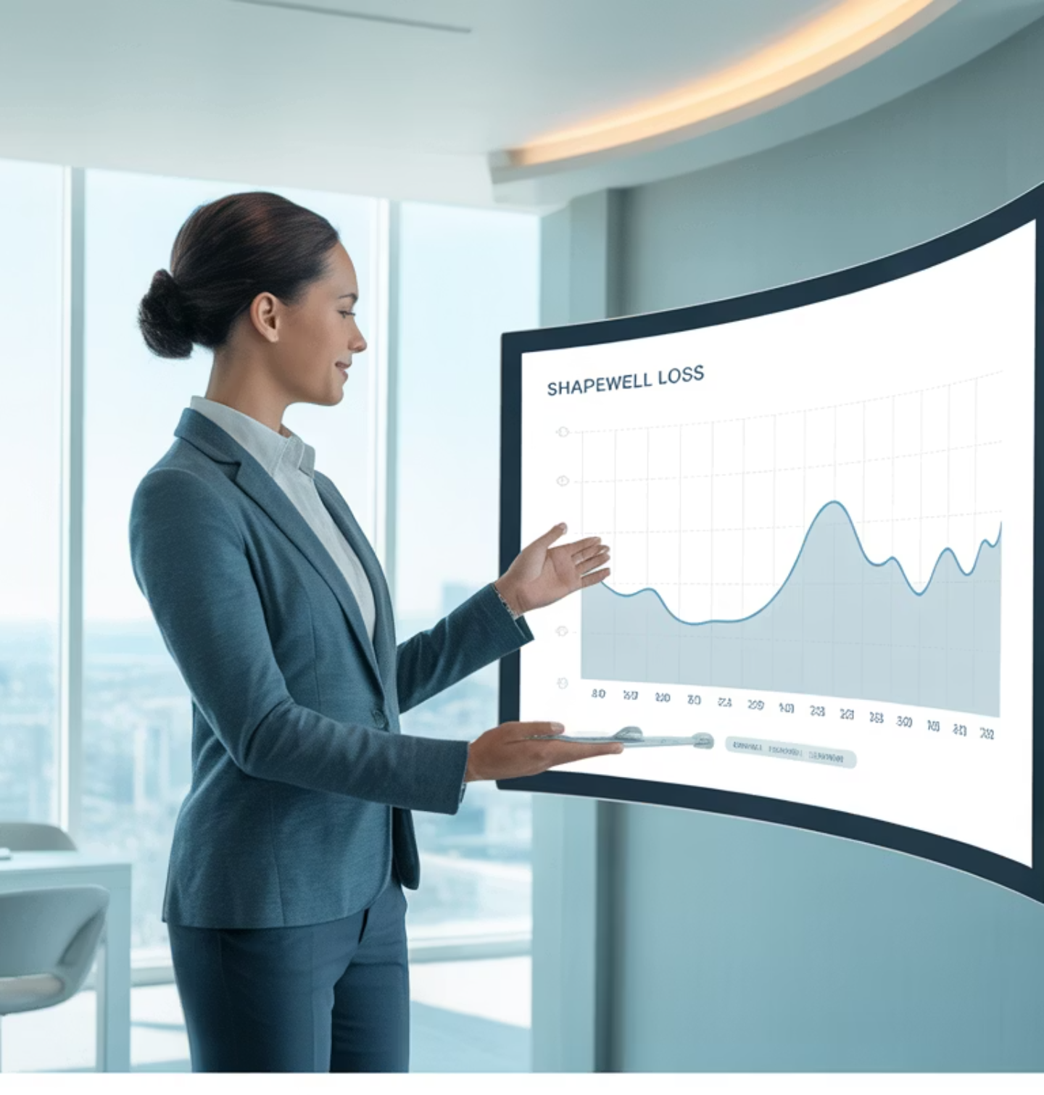
Leader's WHY: Income & Impact
Massive Market
Weight management is one of the largest and fastest-growing wellness industries globally, with people spending billions every year to lose weight, stay fit, and look younger.
Rising Demand
In India, obesity and lifestyle diseases are rising, creating huge demand for natural solutions that actually work.
As a leader, focusing on this category means:
Repeat Business
Building massive repeat business through consumable products that customers reorder monthly.
Life Transformation
Helping people transform their lives, health, and confidence in measurable ways.
Sustainable Income
Creating sustainable residual income through a proven business model.

Slide 5





Why Vestige Weight Management?
Trusted Brand
Scientific Backing
Affordable Quality
Trusted Indian direct selling giant with proven credibility and track record in the wellness industry.
Scientifically backed, natural formulations developed specifically for effective weight management.
High-quality, affordable products vs. expensive international brands - better value for customers.
Repeat Orders
Strong Support
Repeat order potential = consistent business and predictable income streams.
Strong support system: comprehensive training, recognition programs, and active community support.

Slide 6
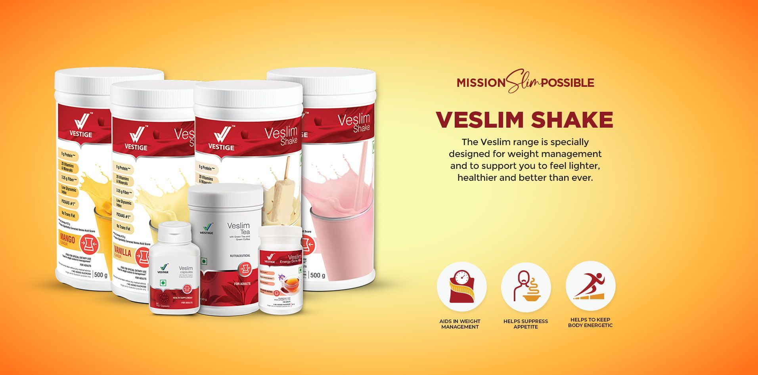

Slide 7





Vestige Product Strengths
Plant-Based Formula
🌱 safe, effective supplements designed with natural ingredients for optimal results.
Complete Range
🥤 Meal replacement shakes, herbal teas, fat burners, and digestive support - everything needed for success.
Indian-Focused
✅ Designed specifically for Indian bodies and lifestyle needs, ensuring better compatibility and results.
Repeat Business
🔄 Repeat consumption → customers reorder every month,
creating sustainable income.

Slide 8





Why This Category Grows Teams Fast
Visible Results
Weight loss is visible → transformations are the best marketing tool you can have. Results speak louder than words.
Natural Sharing
When people see results, they automatically share with friends & family - organic word-of-mouth marketing.
Easy Duplication
Easy to duplicate in teams: One product, one story, one transformation = hundreds of signups and team growth.
Emotional Connection
High emotional connect → "confidence, looks, health, life-change" - powerful motivators for action.

Slide 9

Success Formula
1
Niche Focus
Focused only on weight management niche → built a global empire by becoming the go-to solution for weight loss.
2
Community Challenges
Created community-based transformation challenges that brought people together and created accountability.
3
Social Proof
Built strong before & after success stories → social proof that convinced others to join and try the products.
4
Lifestyle Movement
Positioned weight management as a lifestyle movement, not just products - creating a culture and community.

Slide 10






How to Promote Vestige Weight Management
Weight Loss Challenges
Success Stories
✅ Run 21/30-Day Weight Loss Challenges with community support, accountability, and group motivation.
✅ Share Before & After transformations - real stories sell better than any advertisement!
Complete Package
Customer Groups
✅ Position as complete lifestyle package combining nutrition, motivation, and ongoing support.
✅ Create customer groups on WhatsApp/Telegram for ongoing support, tips, and community building.
Social Media
Workshops
✅ Leverage social media reels & lives → show your own journey and inspire others to start theirs.
✅ Organize weight management workshops both online and offline to educate and attract new customers.

Slide 11

The Leader's Edge
By focusing on this category, you:
Massive Duplication
Attract Quality People
Create massive duplication in your team as success stories inspire others to join and replicate.
Attract people who want health + income - motivated individuals seeking transformation in multiple areas.
Sustainable Income
Build a long-term sustainable income stream through repeat customers and growing teams.
"Be the face of transformation, and your business will transform with you."

Slide 12
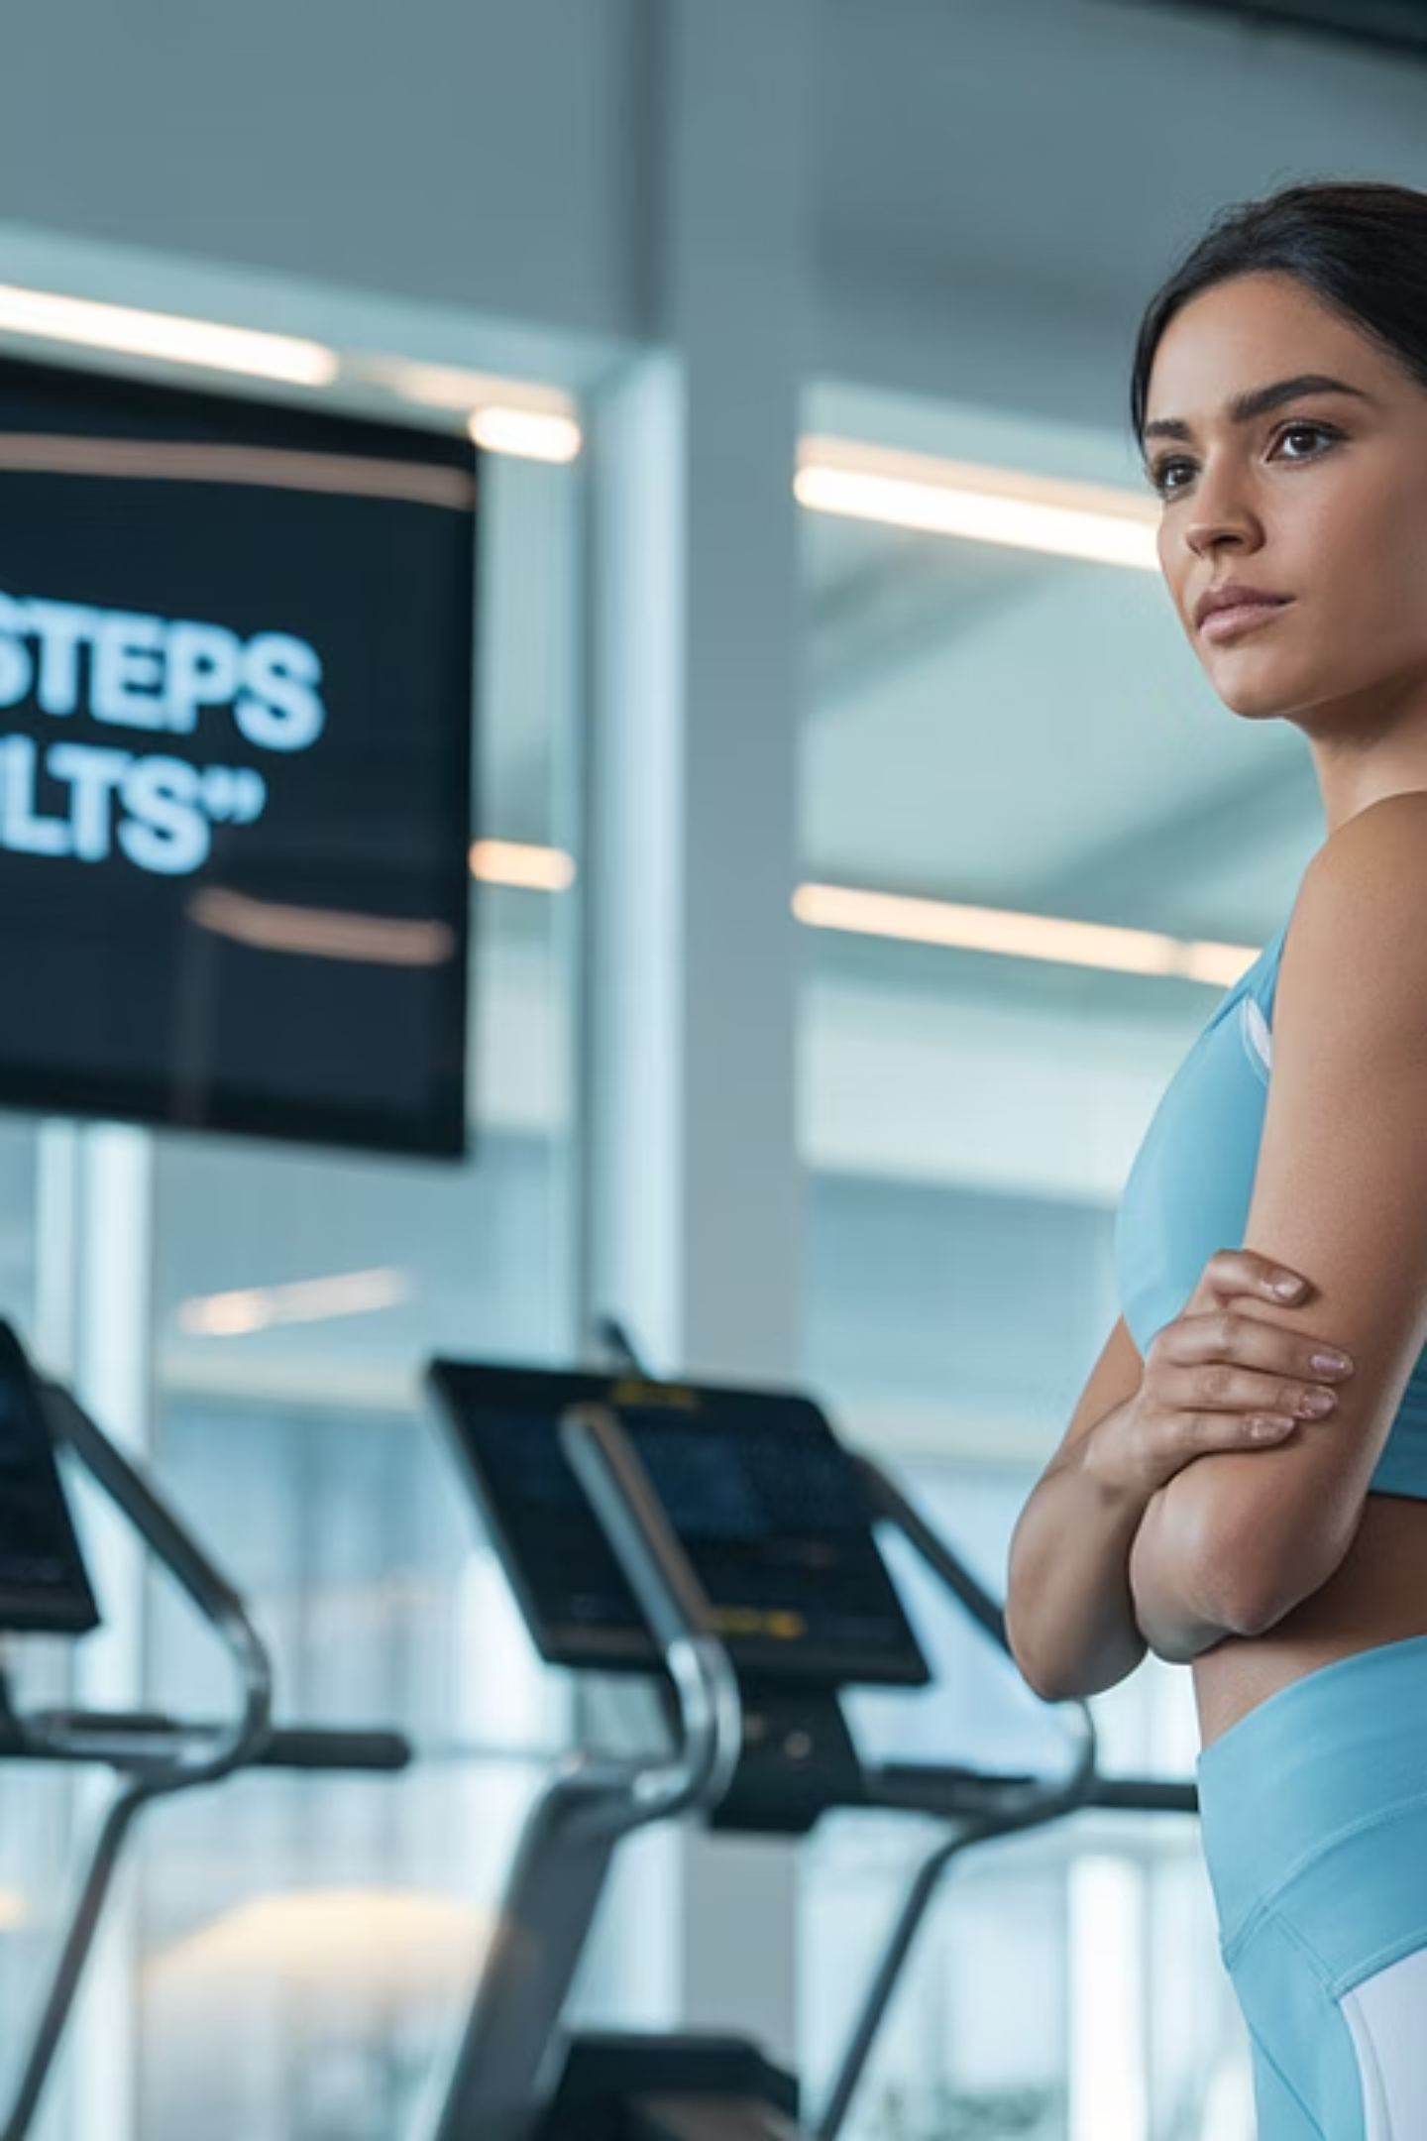
🚀 Start NOW
Choose Products
Choose Vestige weight management products that align with your goals and start your product knowledge journey.
Begin Transformation
Begin your own transformation journey - you must be your own
best testimonial and success story.
Document Journey
Document your journey with photos, measurements, and progress
updates to create compelling content.
Build Community
Build your community of like-minded individuals who want
to transform their health and income together.
"Your story is the best marketing tool."

